Slide 1
OFI Services
2025

Slide 2
1
OFI Overview and Capabilities
2
Life at OFI
3
Roles we’re hiring for
4
What’s in it for you
5
Recruitment process

Slide 3









































OUR CLIENTS
OFI is global leader in process mining services, and offers process mining and automation services for implementation, support and value realization, end-to-end, with 170+ people around the globe.
Our commitment to excellence and innovation has earned us the prestigious title of Celonis Partner of the Year 2023
OUR GLOBAL FOOTPRINT
Customers
Talent
Offices

Slide 4

Our capabilities
Process Mining
Intelligent Automation
We provide enterprise architecture services to help our clients design and implement scalable, secure, and reliable IT systems. Our team has years of experience working with clients across various industries and can help you develop a robust enterprise architecture that aligns with your business goals.
Our RPA application development and management services help clients build, maintain, and enhance their IT systems. We use cutting-edge technologies and best practices to deliver high-quality solutions that meet our clients' needs. Our team has expertise in a range of programming languages and platforms, including Java, .NET, and Python.
Change Management
Pipeline
AI Applications
Value Consulting
We help helping organizations adapt to the insights and process improvements identified through data analysis. It involves preparing, supporting, and guiding employees and stakeholders to adopt new workflows, technologies, or process changes effectively. We ensure that improvements are fully integrated into the organization's culture and operations
We guide our customers in identifying, quantifying and realising the financial and operational benefits of process optimisation. It includes assessing current process inefficiencies, projecting potential improvements through data insights, and developing strategies to maximise ROI using process mining insights. We focus on aligning these improvements with business goals, ultimately delivering measurable value and competitive advantages
We offer data analytics services to help our clients gain secure AI-driven insights from their data and make informed business decisions.

Slide 5





Life at OFI
At OFI, we believe work should be meaningful, collaborative, and full of opportunities to grow.
Our Principles
We hire and develop the best talent.
We are a team of specialists focused on delivering the best service to our clients.
Collaborative and Flat Culture
Global Collaboration
We are committed to achieving the highest quality standards.
We always think big.
We understand that our commitment to high performance is ongoing.
We are highly proactive.
Real-world Impact
Continuous Learning

Slide 6
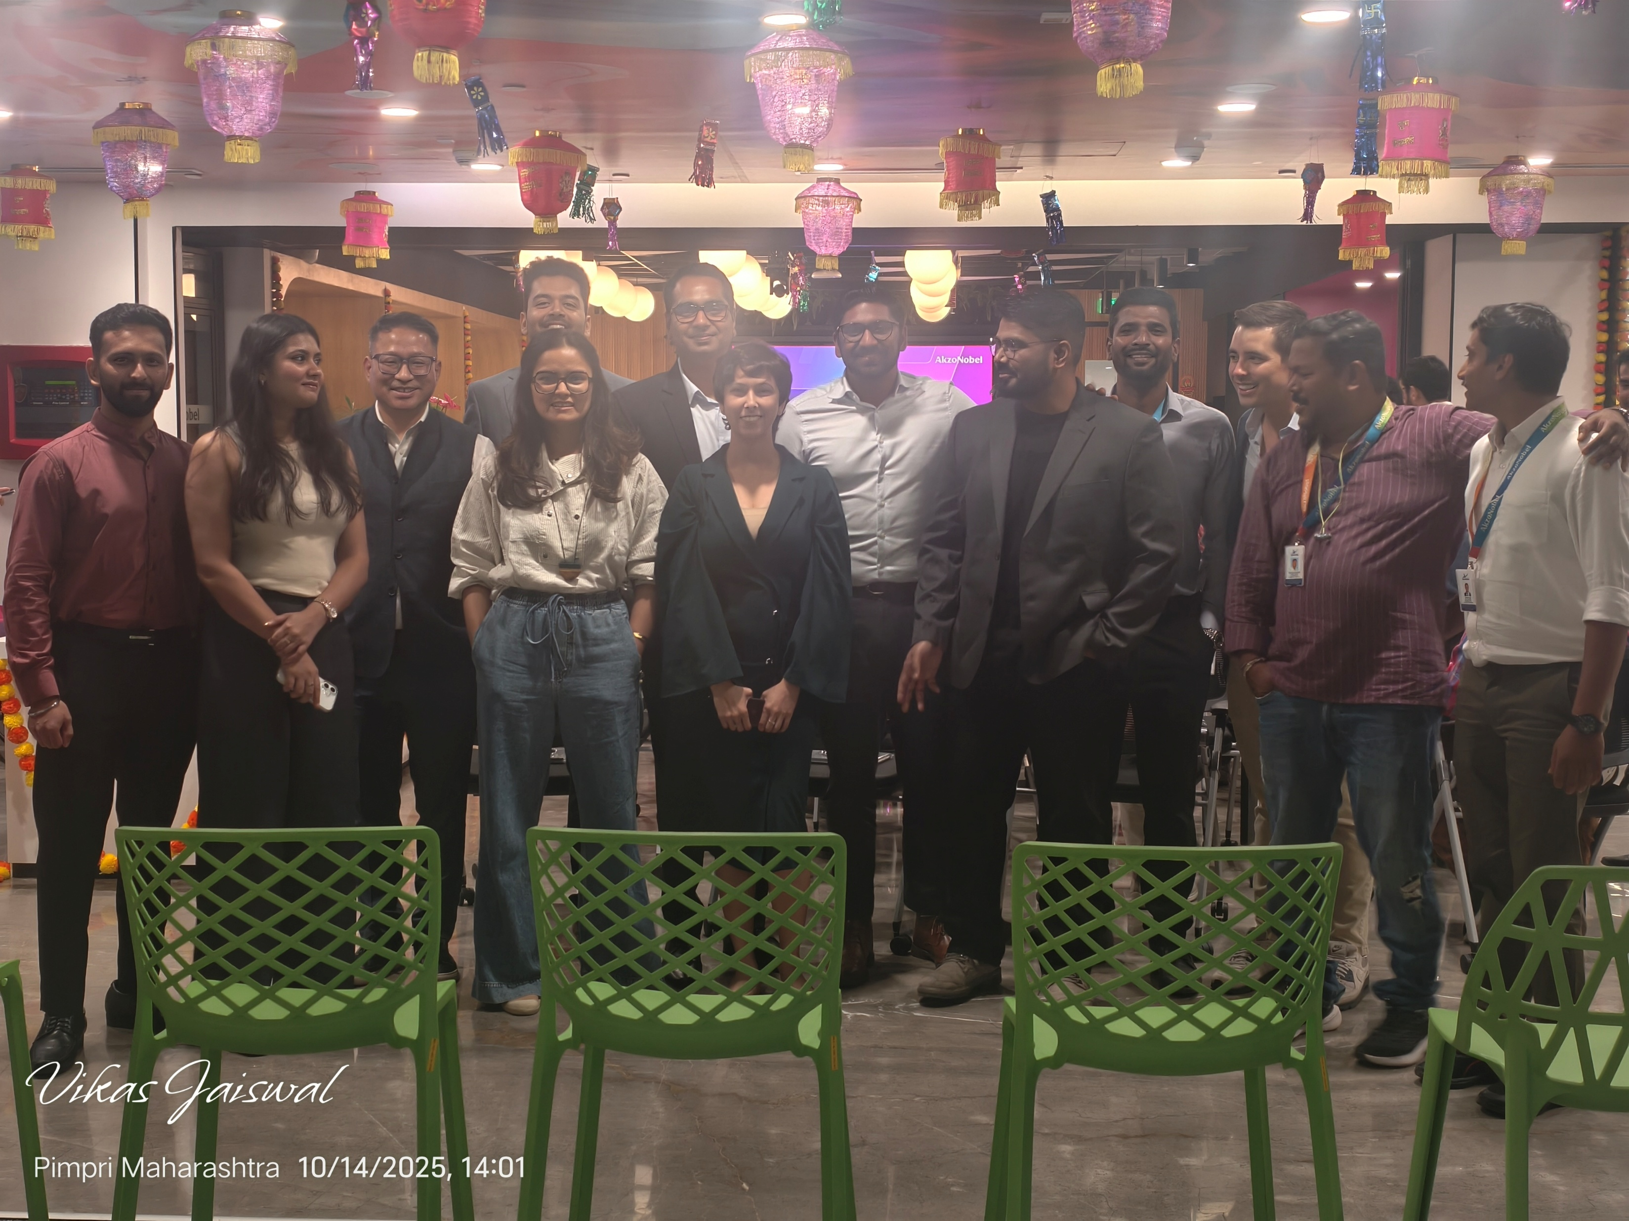
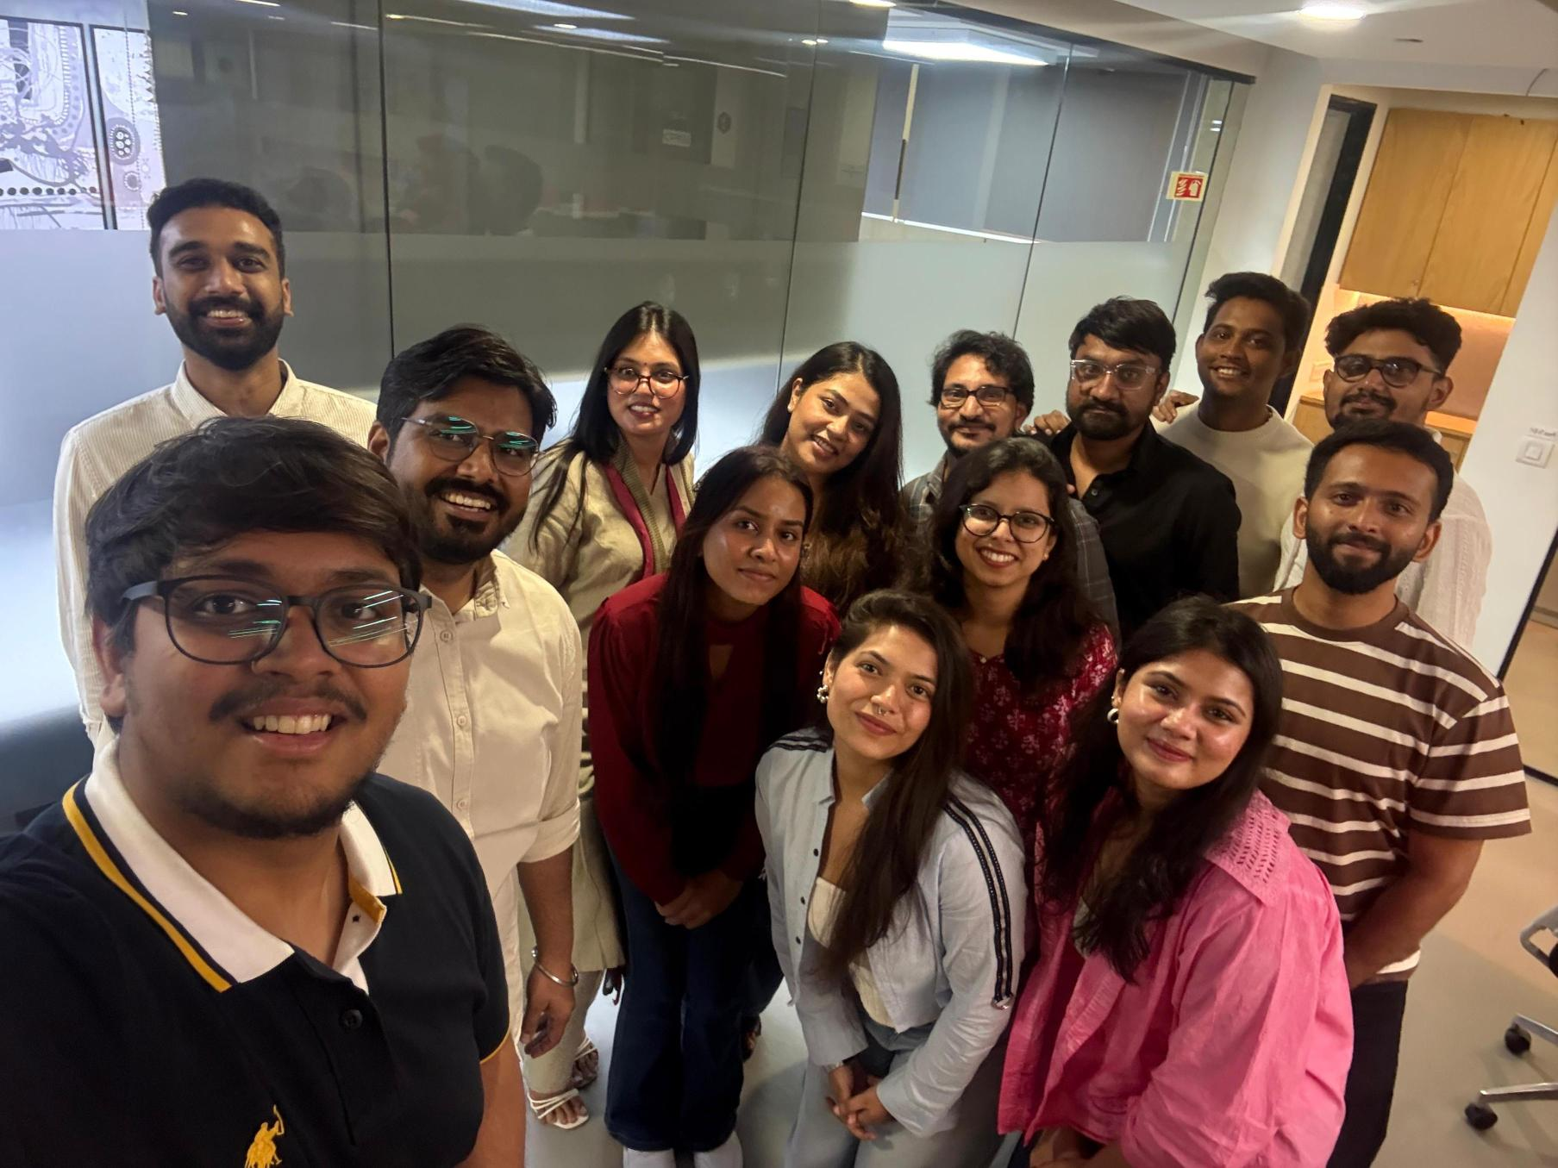
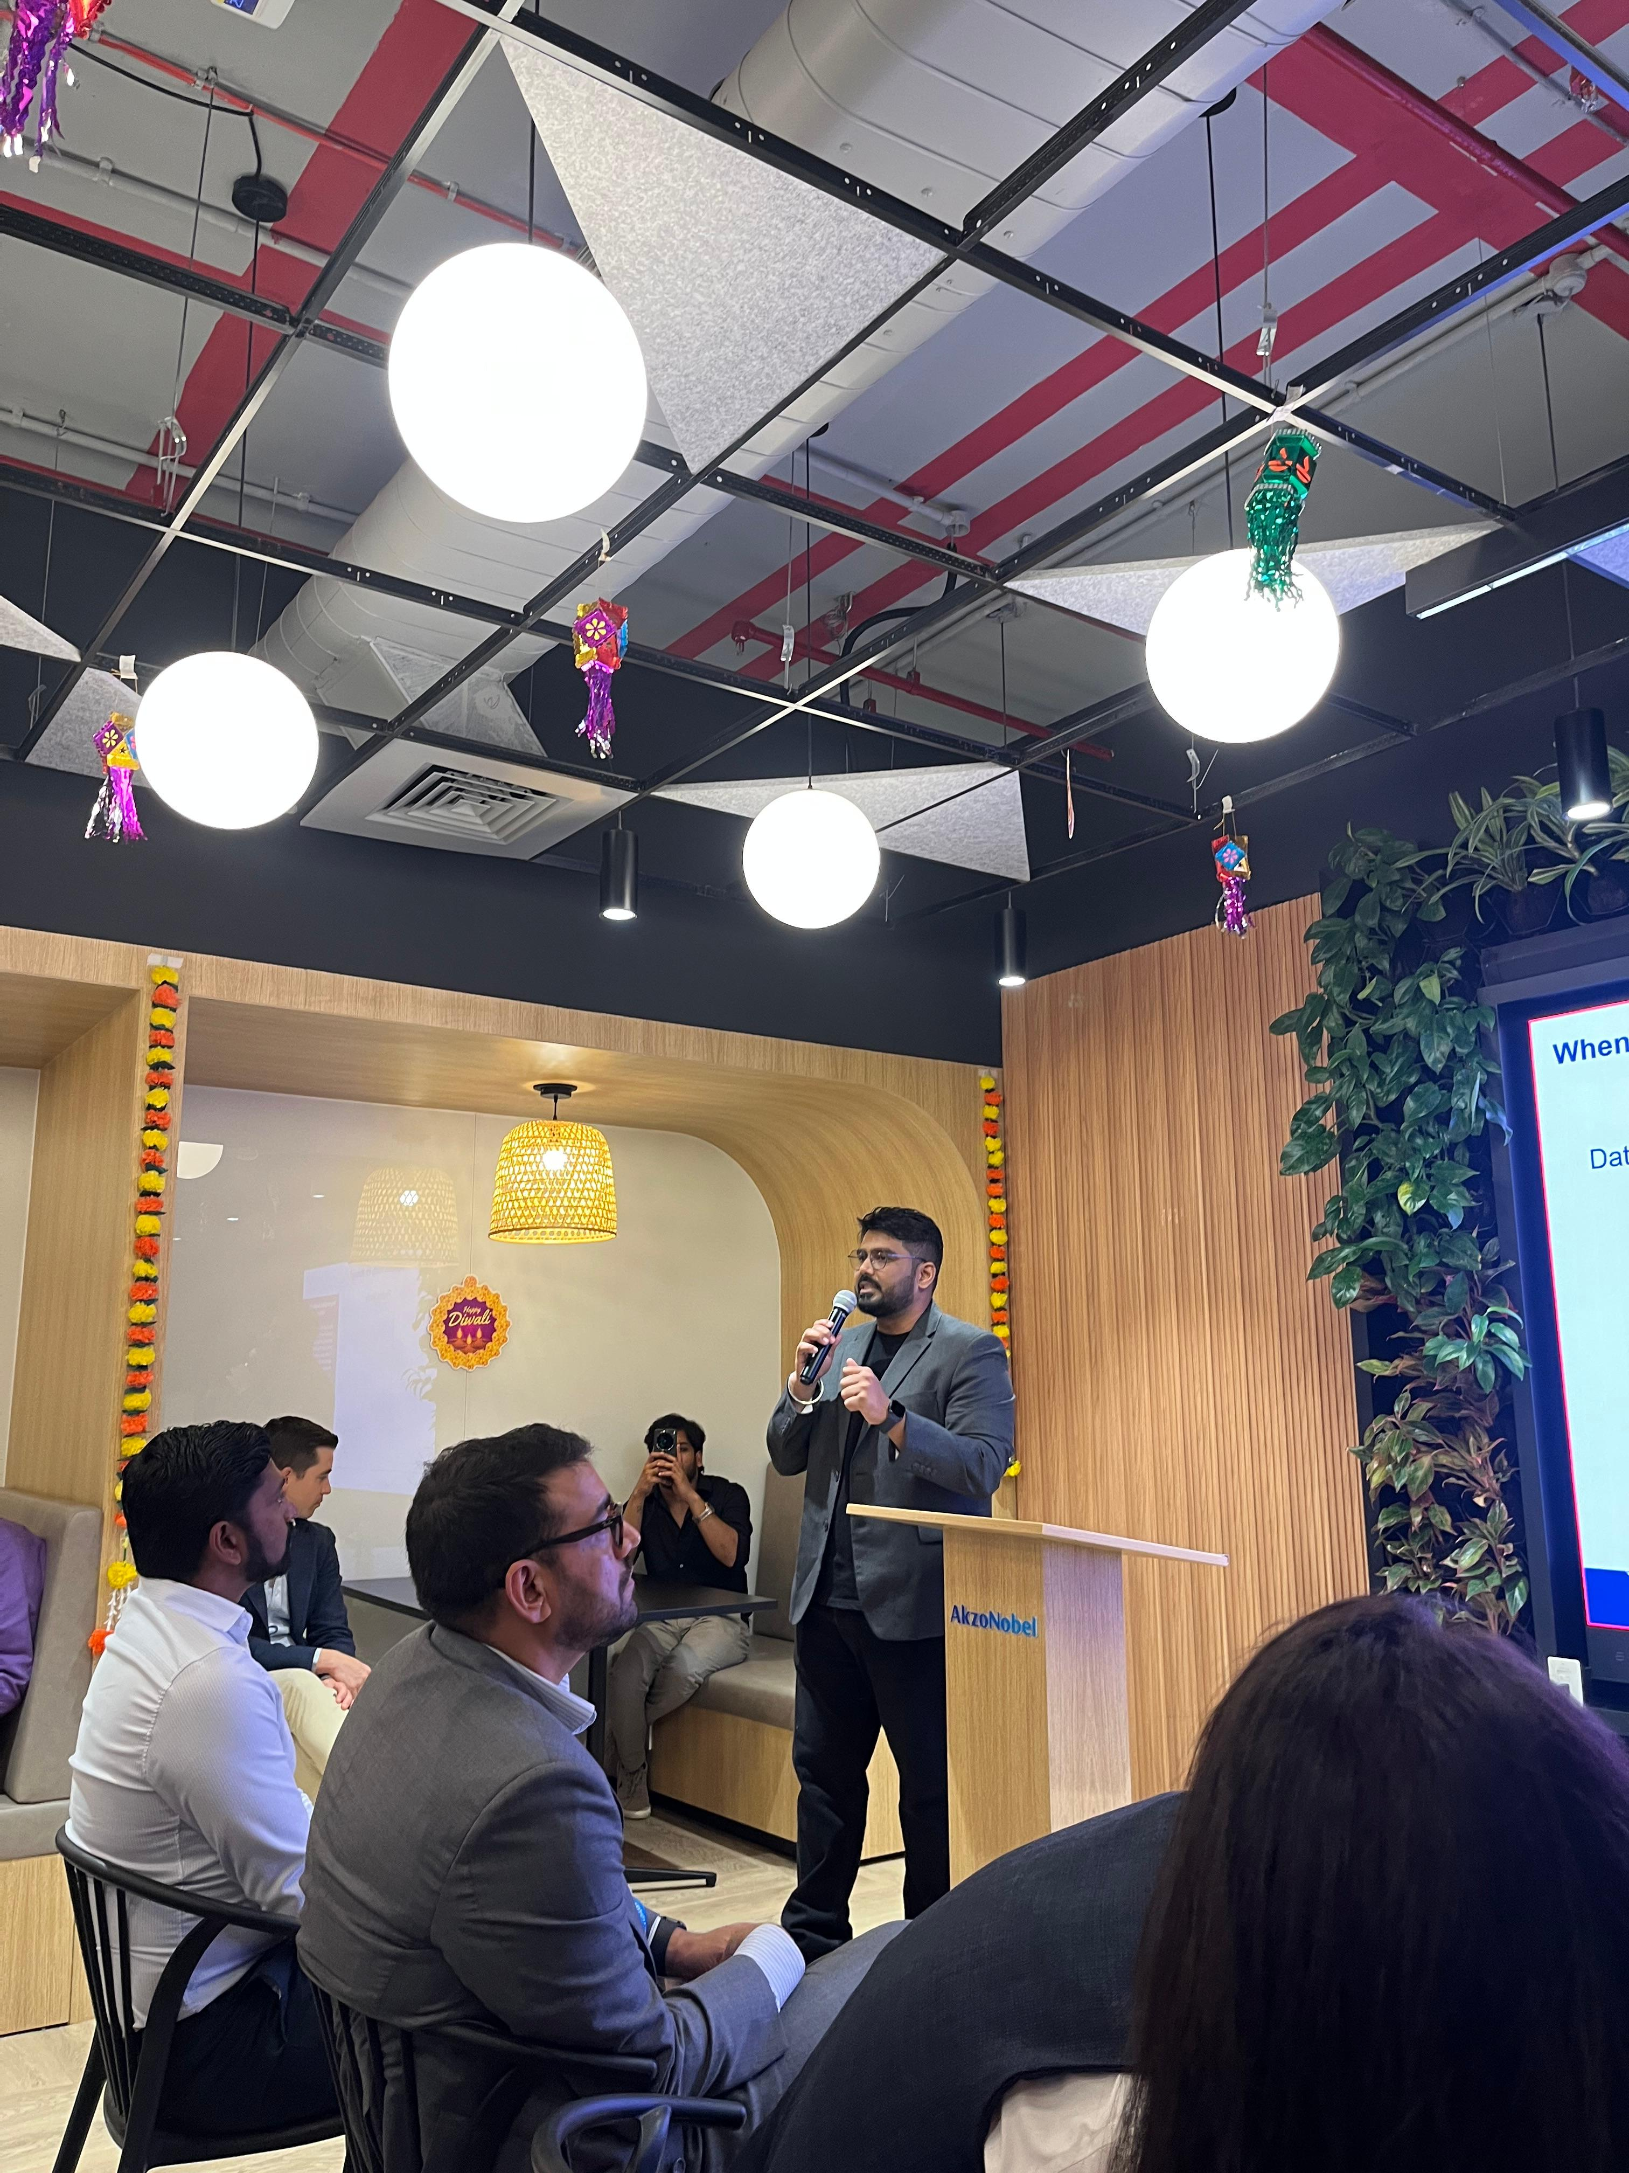
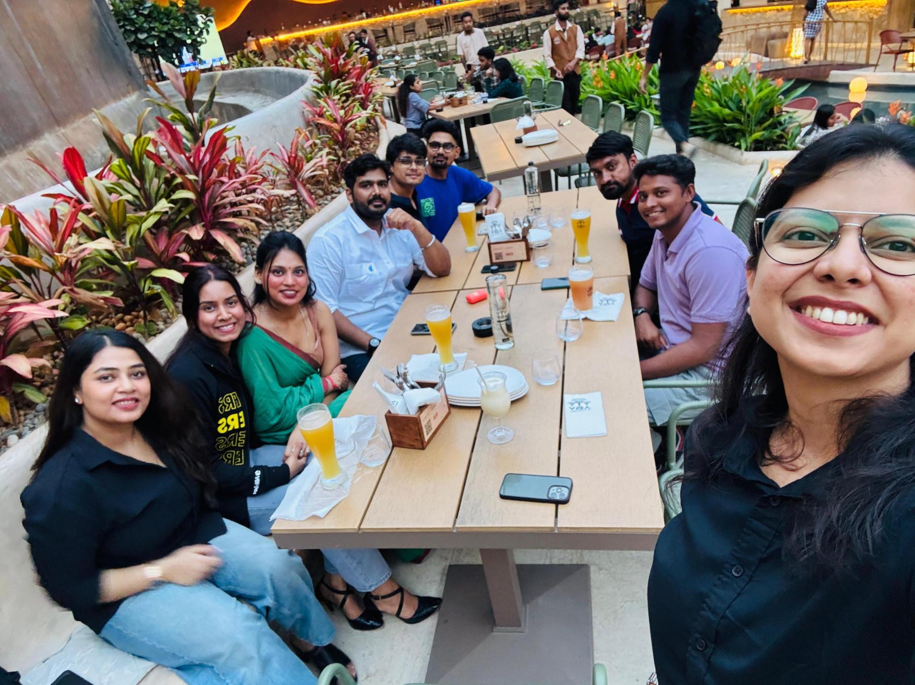
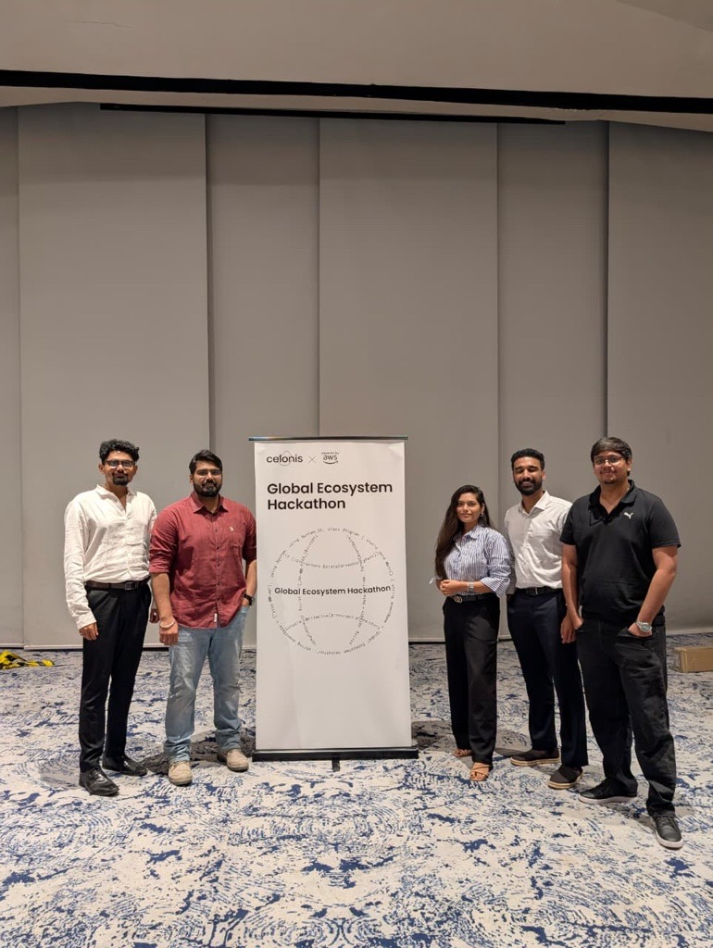

Life at OFI
Notes:
Tags: approach, text

Slide 7






What’s in it for you
A launchpad for analytical minds who want to shape real business impact.
You will learn fast, work directly with global clients, and see your analysis turn into measurable business results.
Grow your career at the intersection of technology, analytics and business transformation.
Young, Entrepreneurial Culture
Global Clients Exposure
Join ambitious problem-solvers
Mentorship
Reporting to and working with senior stakeholders (MD, Directors etc.)
Global stakeholder management and consulting skills
Competitive Pay
Hybrid Operating Model
Continuous Learning
Fixed components and two appraisal cycles yearly
Flexible working model to facilitate collaboration days in office and WFH
Investment in continuous upskilling and mastering new tools/tech

Slide 8





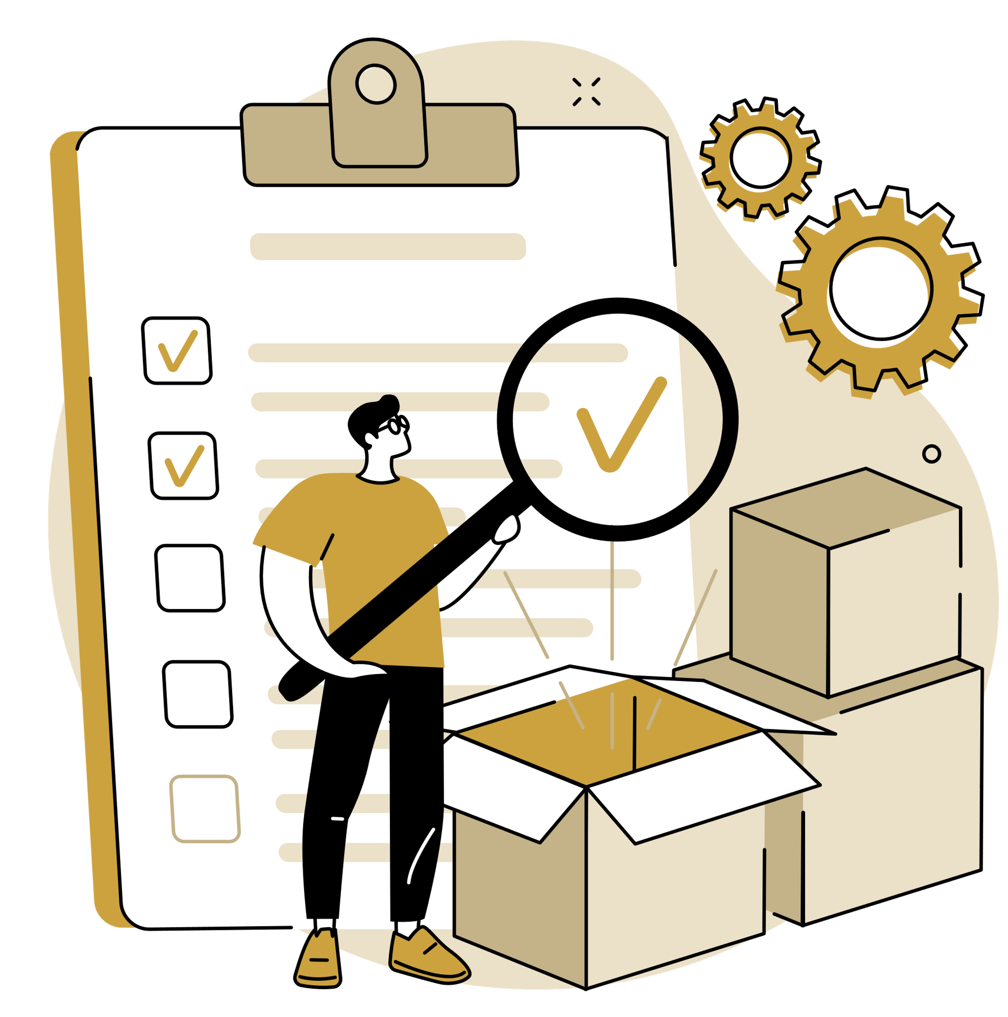
Recruitment Process
Panel Interviews
Resume Shortlisting
Stage 1
Stage 3
Group Discussion
Final Offer
Stage 2
Stage 4

Slide 10
Case Study- LOGISTICS INNOVATION CHALLENGE Tech Stack: Python, Streamlit (Required) + Your Choice Focus: Innovation, Creativity, Problem-Solving Business Context: Company Profile: NexGen Logistics Pvt. Ltd. NexGen Logistics is a mid-sized logistics company operating across India with international connections to Singapore, Dubai, Hong Kong, and Bangkok. The company handles 200+ monthly orders across multiple product categories including Electronics, Fashion, Food & Beverage, Healthcare, Industrial goods, Books, and Home Goods. Current Operations: · 5 major warehouses (Mumbai, Delhi, Bangalore, Chennai, Kolkata) · 50-vehicle fleet (vans, trucks, refrigerated units, express bikes) · 5 carrier partnerships for extended reach · Serving Enterprise, SMB, and Individual customer segments · Handling Express, Standard, and Economy delivery priorities

Slide 11
The Challenge Despite steady growth, NexGen Logistics faces critical challenges threatening its competitive position: . Delivery Performance Issues . Operational Inefficiencies . Cost Pressures . Limited Innovation . Sustainability Concerns NexGen's leadership has identified the need to: · Transform from reactive to predictive operations · Build data-driven decision-making culture · Improve customer experience significantly · Reduce operational costs by 15-20% · Position as an innovation leader in logistics

Slide 12
Your Mission You've been hired as a Logistics Innovation Analyst to help NexGen transform its operations using data analytics and innovative tools. The Mandate (Choose Your Own Adventure) You have access to 7 different datasets covering the entire logistics ecosystem. Your task is to: . Identify a specific problem worth solving (based on data exploration) . Design an innovative solution that could transform operations . Build a working prototype using Python and Streamlit . Demonstrate business impact through your analysis This is intentionally open-ended. We want to see: · How you think about problems · What you consider important · Your creativity in solution design · Your technical execution skills · How you communicate value

Slide 13
Dataset Overview You have access to 7 CSV files with interconnected data
Data File | Description
orders.csv (200 records) | Order-level information including: Order IDs, dates, customer segments Priority levels (Express/Standard/Economy) Product categories Order values, origins, destinations Special handling requirements
delivery_performance.csv (150 records) | Delivery execution data: Carrier assignments Promised vs actual delivery times Delivery status classifications Quality issues (damage, wrong items, etc.) Customer ratings (1-5 stars) Delivery costs

Slide 14
routes_distance.csv (150 records) | Route-specific metrics: Distance traveled per order Fuel consumption Toll charges Traffic delays Weather impact
vehicle_fleet.csv (50 records) | Fleet information: Vehicle types and capacities Fuel efficiency ratings Current locations and status Vehicle age CO2 emissions per kilometer
warehouse_inventory.csv (35 records) | Inventory data across 5 warehouses: Stock levels by product category Reorder levels Storage costs Last restocked dates

Slide 15
warehouse_inventory.csv (35 records) | Inventory data across 5 warehouses: Stock levels by product category Reorder levels Storage costs Last restocked dates
customer_feedback.csv (83 records) | Customer voice data: Ratings and feedback text Recommendation likelihood Issue categories Feedback dates
cost_breakdown.csv (150 records) | Detailed cost components: Fuel, labor, maintenance costs Insurance and packaging costs Technology platform fees Other overhead
NOTE: Not all orders have complete data across all files (some orders are recent and still in transit). This reflects real-world scenarios.

Slide 16
Please access and download the dataset here -Dataset Possible Problem Areas (Pick One or Define Your Own) Option 1: Predictive Delivery Optimizer: Build a tool that predicts delivery delays before they happen and suggests corrective actions. Option 2: Smart Route Planner: Design an intelligent routing system that optimizes for cost, time, and environmental impact. Option 3: Dynamic Fleet Manager: Create a system that matches the right vehicle to the right order based on multiple constraints. Option 4: Customer Experience Dashboard: Build a comprehensive tool that identifies at-risk customers and suggests interventions. Option 5: Cost Intelligence Platform: Develop analytics to identify cost leakage and optimization opportunities. Option 6: Warehouse Optimization Tool: Design a system for optimal inventory placement and rebalancing across warehouses. Option 7: Sustainability Tracker: Create a carbon footprint tracker with recommendations for greener operations. Option 8: Your Own Idea: Identify a unique problem from the data and create an innovative solution!

Slide 17
Mandatory Technical Requirements and Deliverables
Technical requirements:
Requirement | Description
Python and Streamlit | Must use Python for all data processing and analysis Must build an interactive web application using Streamlit Application should run locally with: streamlit run your_app.py
Data Analysis | Load and analyze multiple datasets Perform meaningful calculations and derive insights Handle missing data appropriately Create derived metrics that add business value
Visualization | Include at least 4 different types of charts/visualizations Visualizations should be interactive where possible Use appropriate chart types for the data being presented
Interactivity | Include filters, selections, or user inputs Dashboard should respond dynamically to user choices Provide download or export functionality
Code Quality | Well-organized, readable code Appropriate comments and documentation Proper error handling Efficient data processing
Final deliverables:
Innovation Brief (PDF)
README.md
Any additional supporting files
Python application file(s)
requirements.txt

Slide 18
Evaluation Criteria
Category | Points | Evaluation Metric
Problem Selection & Justification | 15 | Clarity, importance, business alignment
Innovation & Creativity | 20 | Originality, thinking beyond obvious solutions
Technical Implementation | 20 | Code quality, functionality, performance
Data Analysis Quality | 15 | Depth of analysis, insight generation
Tool Usability (UX) | 10 | Intuitive design, user-friendliness
Visualizations | 10 | Appropriate, clear, impactful
Business Impact | 10 | Clear value proposition, ROI potential
Bonus: Advanced Features | +20 | ML, optimization, innovative extras

